Slide 1

Introduction to Machine Learning using Python

Slide 2
Introduction to Predictive Analytics
1 | Types of ML problems
2 | Introduction to Simple and Multiple Linear Regression
3 | Interpreting Regression models
4 | Case study

Slide 3
What is Machine Learning?
“Learning is any process by which a system improves performance from experience.”
- Herbert Simon
Definition by Tom Mitchell (1998):
Machine Learning is the study of algorithms that
improve their performance P
at some task T
with experience E.
A well-defined learning task is given by <P, T, E>.

Slide 4
Traditional Programming
Data Program
Computer
Output
Machine Learning
Data Output
Computer
Program
4

Slide 5
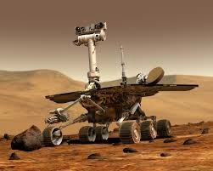
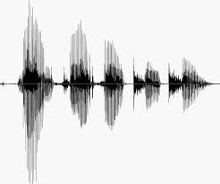
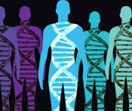
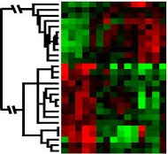
When Do We Use Machine Learning?
ML is used when:
Human expertise does not exist (navigating on Mars)
Humans can’t explain their expertise (speech recognition)
Models must be customized (personalized medicine)
Models are based on huge amounts of data (genomics)
Learning isn’t always useful:
There is no need to “learn” to calculate payroll
5

Slide 6
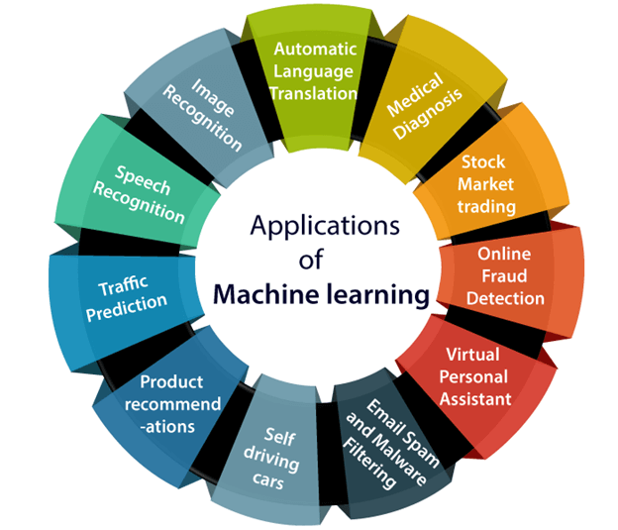
When Do We Use Machine Learning?

Slide 7

Some more examples of tasks that are best solved by using a learning algorithm
Recognizing patterns:
Facial identities or facial expressions
Handwritten or spoken words
Medical images
Generating patterns:
Generating images or motion sequences
Recognizing anomalies:
Unusual credit card transactions
Unusual patterns of sensor readings in a nuclear power plant
Prediction:
Future stock prices or currency exchange rates
7

Slide 8
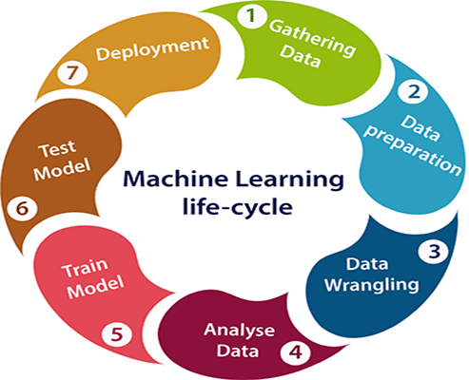

Slide 9
Defining the Learning Task
Improve on task T, with respect to performance metric P, based on experience E
T: Playing checkers
P: Percentage of games won against an arbitrary opponent E: Playing practice games against itself
T: Recognizing hand-written words
P: Percentage of words correctly classified
E: Database of human-labeled images of handwritten words
T: Driving on four-lane highways using vision sensors
P: Average distance traveled before a human-judged error
E: A sequence of images and steering commands recorded while observing a human driver.
T: Categorize email messages as spam or legitimate. P: Percentage of email messages correctly classified. E: Database of emails, some with human-given labels
10

Slide 10
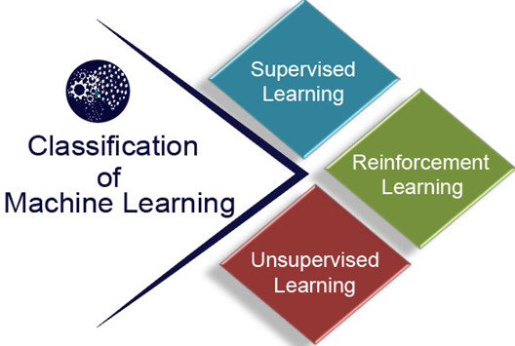
Classification of Machine Learning

Slide 11
Types of Learning
Supervised (inductive) learning
Given: training data + desired outputs (labels)
Unsupervised learning
Given: training data (without desired outputs)
Semi-supervised learning
Given: training data + a few desired outputs
Reinforcement learning
Rewards from sequence of actions
24

Slide 12
Supervised Machine Learning
Supervised learning is the types of machine learning in which machines are trained using well "labelled" training data, and on basis of that data, machines predict the output. The labelled data means some input data is already tagged with the correct output.
In supervised learning, the training data provided to the machines work as the supervisor that teaches the machines to predict the output correctly. It applies the same concept as a student learns in the supervision of the teacher.
Supervised learning is a process of providing input data as well as correct output data to the machine learning model. The aim of a supervised learning algorithm is to find a mapping function to map the input variable(x) with the output variable(y).

Slide 13
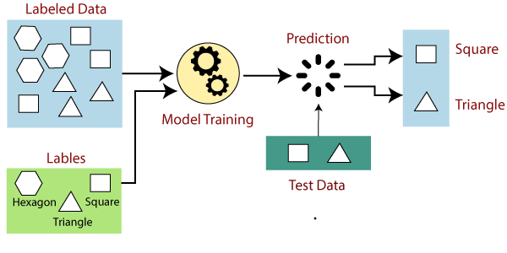
How Supervised Learning Works?

Slide 14
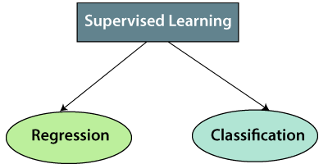
Types of supervised Machine learning Algorithms
Regression
Regression analysis is a statistical method to model the relationship between a dependent (target) and independent (predictor) variables with one or more independent variables. To understand how the value of the dependent variable is changing corresponding to an independent variable when other independent variables are held fixed. It predicts continuous/real values such as temperature, age, salary, price,
Classification
The Classification algorithm is a Supervised Learning technique that is used to identify the category of new observations on the basis of training data. In Classification, a program learns from the given dataset and then classifies new observation into a number of classes or groups. Such as, Yes or No, 0 or 1, Spam or Not Spam, cat or dog, etc. Classes can be called as targets/labels or categories.

Slide 15



Supervised Learning: Regression
Given (x₁, y₁), (x₂, y₂), ..., (x_{n}, y_{n})
Learn a function f(x) to predict y given x
– y is real-valued == regression
9
8
7
6
5
4
3
2
1
0
1970 1980
September Arctic Sea Ice Extent (1,000,000 sq km)
1990 2000
2010
2020
Year
26

Slide 16










Supervised Learning: Classification
Given (x₁, y₁), (x₂, y₂), ..., (x_{n}, y_{n})
Learn a function f(x) to predict y given x
– y is categorical == classification
Breast Cancer (Malignant / Benign)
1(Malignant)
0(Benign)
Tumor Size
27

Slide 17







Supervised Learning: Classification
Given (x₁, y₁), (x₂, y₂), ..., (x_{n}, y_{n})
Learn a function f(x) to predict y given x
– y is categorical == classification
Breast Cancer (Malignant / Benign)
1(Malignant)
0(Benign)
Tumor Size
Tumor Size

Slide 18






Supervised Learning: Classification
Given (x₁, y₁), (x₂, y₂), ..., (x_{n}, y_{n})
Learn a function f(x) to predict y given x
– y is categorical == classification
Breast Cancer (Malignant / Benign)
1(Malignant)
0(Benign)
Tumor Size
Predict Benign Predict Malignant
Tumor Size

Slide 19










Supervised Learning
x can be multi-dimensional
– Each dimension corresponds to an attribute
Clump Thickness
Uniformity of Cell Size
Uniformity of Cell Shape
…
Age
Tumor Size
30

Slide 20
Unsupervised Machine Learning
Unsupervised learning is a type of machine learning in which models are trained using unlabeled dataset and are allowed to act on that data without any supervision.
The goal of unsupervised learning is to find the underlying structure of dataset, group that data according to similarities, and represent that dataset in a compressed format.
Why use Unsupervised Learning?
Unsupervised learning is helpful for finding useful insights from the data.
Unsupervised learning is much similar as a human learns to think by their own experiences, which makes it closer to the real AI.
Unsupervised learning works on unlabeled and uncategorized data which make unsupervised learning more important.
In real-world, we do not always have input data with the corresponding output so to solve such cases, we need unsupervised learning.

Slide 21
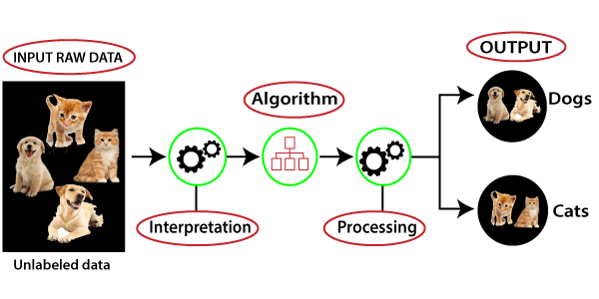
Working of Unsupervised Learning

Slide 22
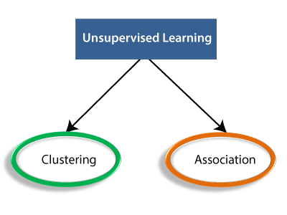
Types of Unsupervised Learning Algorithm
Clustering: Clustering is a method of grouping the objects into clusters such that objects with most similarities remains into a group and has less or no similarities with the objects of another group. Cluster analysis finds the commonalities between the data objects and categorizes them as per the presence and absence of those commonalities.
Association: An association rule is an unsupervised learning method which is used for finding the relationships between variables in the large database. It determines the set of items that occurs together in the dataset. Association rule makes marketing strategy more effective. Such as people who buy X item (suppose a bread) are also tend to purchase Y (Butter/Jam) item. A typical example of Association rule is Market Basket Analysis.

Slide 23
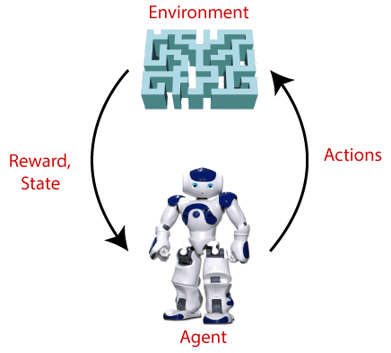
Reinforcement Learning
Reinforcement Learning is a feedback-based Machine learning technique in which an agent learns to behave in an environment by performing the actions and seeing the results of actions. For each good action, the agent gets positive feedback, and for each bad action, the agent gets negative feedback or penalty.
"Reinforcement learning is a type of machine learning method where an intelligent agent (computer program) interacts with the environment and learns to act within that.“
such as game-playing, robotics, etc.

Slide 24
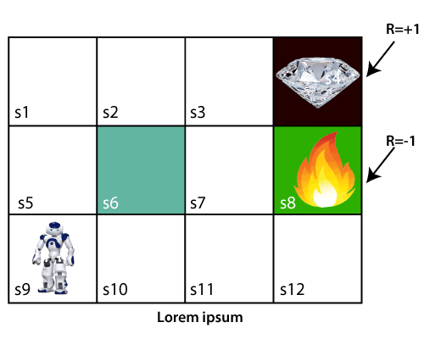
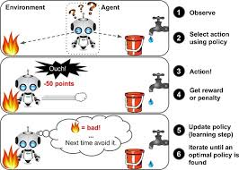
experiments

Slide 25
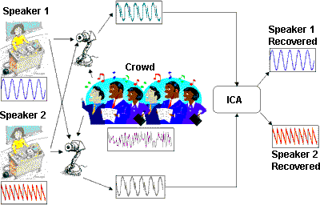


Unsupervised Learning
Independent component analysis – separate a combined signal into its original sources

Slide 26
Reinforcement Learning
Given a sequence of states and actions with (delayed) rewards, output a policy
Policy is a mapping from states → actions that tells you what to do in a given state
Examples:
Credit assignment problem
Game playing
Robot in a maze
Balance a pole on your hand

Slide 27
Regression Analysis in Machine learning
Regression analysis is a statistical method to model the relationship between a dependent (target) and independent (predictor) variables with one or more independent variables.
More specifically, Regression analysis helps us to understand how the value of the dependent variable is changing corresponding to an independent variable when other independent variables are held fixed. It predicts continuous/real values such as temperature, age, salary, price, etc.

Slide 28
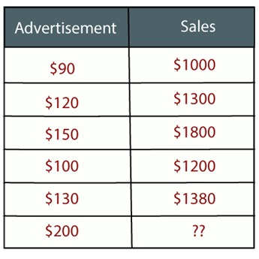
Example:
Suppose there is a marketing company A, who does various advertisement every year and get sales on that. The below list shows the advertisement made by the company in the last 5 years and the corresponding sales:
Now, the company wants to do the advertisement of $200 in the year 2019 and wants to know the prediction about the sales for this year. So to solve such type of prediction problems in machine learning, we need regression analysis.

Slide 29
Regression Use Cases
Determining the strength of Predictors-Prediction of rain using temperature and other factors, Relation between age & income, Sales & marketing.
Forecasting an Effect- Effect of change how much dependent variable changes with the effect of independent variable. Example How much additional sale income will I get each 1000Rs spend on marketing?
Determining Market trends/trend forecasting- How many corona cases will be in India in next 6 months, Prediction of road accidents due to rash driving.

Slide 30
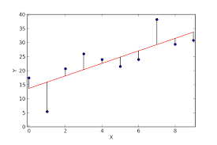
Regression Line
Regression shows a line or curve that passes through all the data points on target-predictor graph in such a way that the vertical distance between the data points and the regression line is minimum."
The distance between data points and line tells whether a model has captured a strong relationship or not.

Slide 31
Terminologies Related to the Regression Analysis
Dependent Variable: The main factor in Regression analysis which we want to predict or understand is called the dependent variable. It is also called target variable.
Independent Variable: The factors which affect the dependent variables or which are used to predict the values of the dependent variables are called independent variable, also called as a predictor.
Outliers: Outlier is an observation which contains either very low value or very high value in comparison to other observed values.
Multicollinearity: If the independent variables are highly correlated with each other than other variables, then such condition is called Multicollinearity. It should not be present in the dataset, because it creates problem while ranking the most affecting variable.
Underfitting and Overfitting: If our algorithm works well with the training dataset but not well with test dataset, then such problem is called Overfitting. And if our algorithm does not perform well even with training dataset, then such problem is called underfitting.

Slide 32
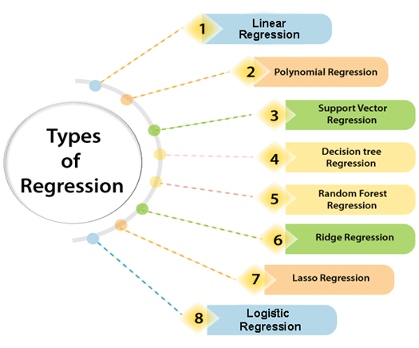

Slide 33
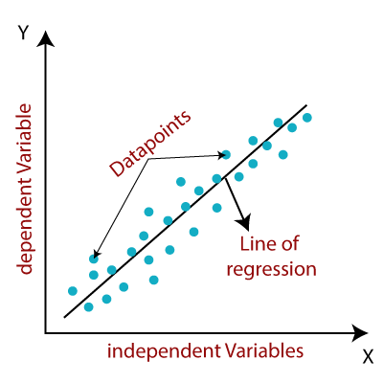
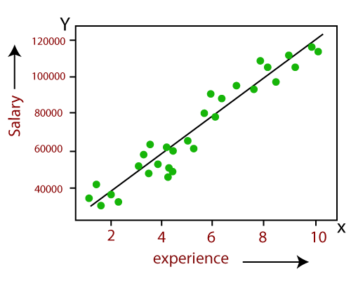
Linear Regression in Machine Learning
It is a statistical method that is used for predictive analysis. Linear regression makes predictions for continuous/real or numeric variables such as sales, salary, age, product price, etc.
The linear regression model provides a sloped straight line representing the relationship between the variables.

Slide 34
Applications of Linear Regression
Analyzing trends and sales estimates (Time on X-axis & Sale on Y axis, forecast sale in future months)
Sales forecasting (Company increases the price of product & analyze Customer consumption-Future pricing decisions)
Real estate prediction
Arriving at ETAs in traffic
Assessment of risk in financial & insurance domain

Slide 35
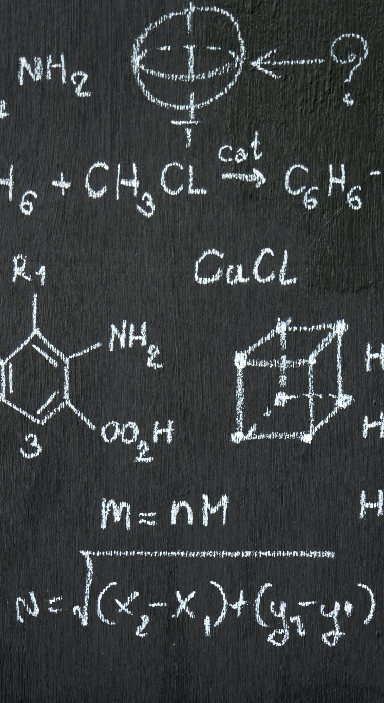
Representation of Linear Regression
Mathematically, we can represent a linear regression as:
y= a₀+a₁x
Here,
Y= Dependent Variable (Target Variable) X= Independent Variable (predictor Variable) a0= intercept of the line (Gives an additional degree of freedom) a1 = Linear regression coefficient (scale factor to each input value). The values for x and y variables are training datasets for Linear Regression model representation.
Ex- Salary=f(Age)

Slide 36
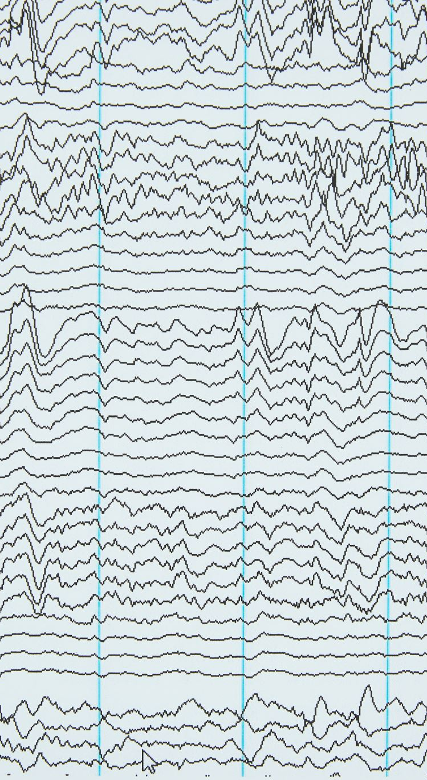
Types of Linear Regression
Simple Linear Regression:
If a single independent variable is used to predict the value of a numerical dependent variable, then such a Linear Regression algorithm is called Simple Linear Regression. Salary=f(Age)
Multiple Linear regression:
If more than one independent variable is used to predict the value of a numerical dependent variable, then such a Linear Regression algorithm is called Multiple Linear Regression.
Salary=f(Age, Experience..)

Slide 37
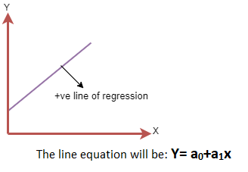
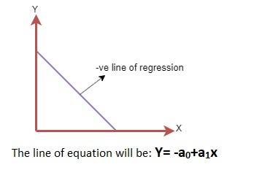
A linear line showing the relationship between the dependent and independent variables is called a regression line.
Positive Linear Relationship: If the dependent variable increases on the Y-axis and independent variable increases on X-axis, then such a relationship is termed as a Positive linear relationship. Speed Vs Distance
Negative Linear Relationship: If the dependent variable decreases on the Y-axis and independent variable increases on the X-axis, then such a relationship is called a negative linear relationship. Speed Vs Time

Slide 38
Finding the best fit line:
When working with linear regression, our main goal is to find the best fit line that means the error between predicted values and actual values should be minimized. The best fit line will have the least error.
The different values for weights or the coefficient of lines (a₀, a₁) gives a different line of regression, so we need to calculate the best values for a₀ and a₁ to find the best fit line, so to calculate this we use cost function.

Slide 39
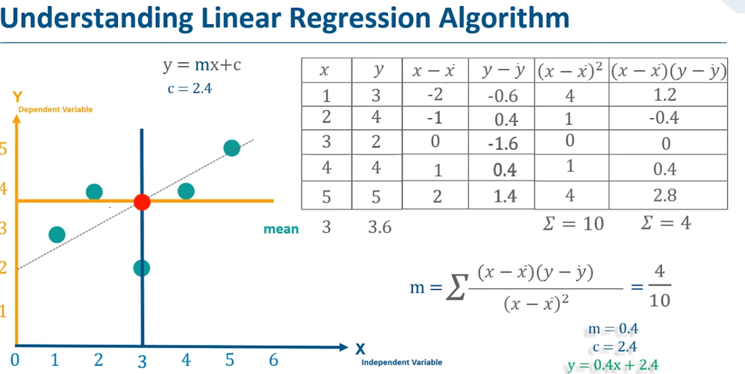

Slide 40
Cost function
The different values for weights or coefficient of lines (a₀, a₁) gives the different line of regression, and the cost function is used to estimate the values of the coefficient for the best fit line.
Cost function optimizes the regression coefficients or weights. It measures how a linear regression model is performing.
We can use the cost function to find the accuracy of the mapping function, which maps the input variable to the output variable. This mapping function is also known as Hypothesis function.

Slide 41
Problem Statement example for Simple Linear Regression
Here we are taking a dataset that has two variables: salary (dependent variable) and experience (Independent variable). The goals of this problem is:
We want to find out if there is any correlation between these two variables
We will find the best fit line for the dataset.
How the dependent variable is changing by changing the dependent variable.
In this section, we will create a Simple Linear Regression model to find out the best fitting line for representing the relationship between these two variables.
Years Experience | Salary
1.1 | 39343
1.3 | 46205
1.5 | 37731
2 | 43525
2.2 | 39891
2.9 | 56642
3 | 60150
3.2 | 54445
3.2 | 64445
3.7 | 57189
3.9 | 63218
4 | 55794
4 | 56957
4.1 | 57081
4.5 | 61111
4.9 | 67938
5.1 | 66029

Slide 42
